Slide 1
PIQL: A Performance Insightful Query Language
Michael Armbrust, Peter Bodík, Kristal Curtis, Durga Kandasamy, Tim Kraska, Nick Lanham, Beth Trushkowsky, Stephen Tu, Armando Fox, Michael Franklin, Michael Jordan, David Patterson

Slide 2


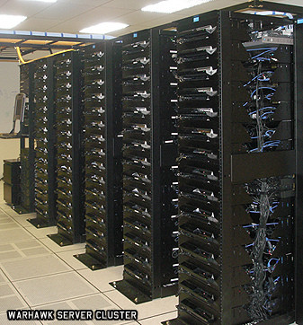



RAD Lab Overview
DeployLib
Mesos
RAIN: Workload
Director
“I” in PIQL
PIQL
SCADS
MPI
Director
NS1
Director
NS2
SPARK: SCADr Spam Filtering
Dashboard
Director
NSX
Data Center Replay

Slide 3
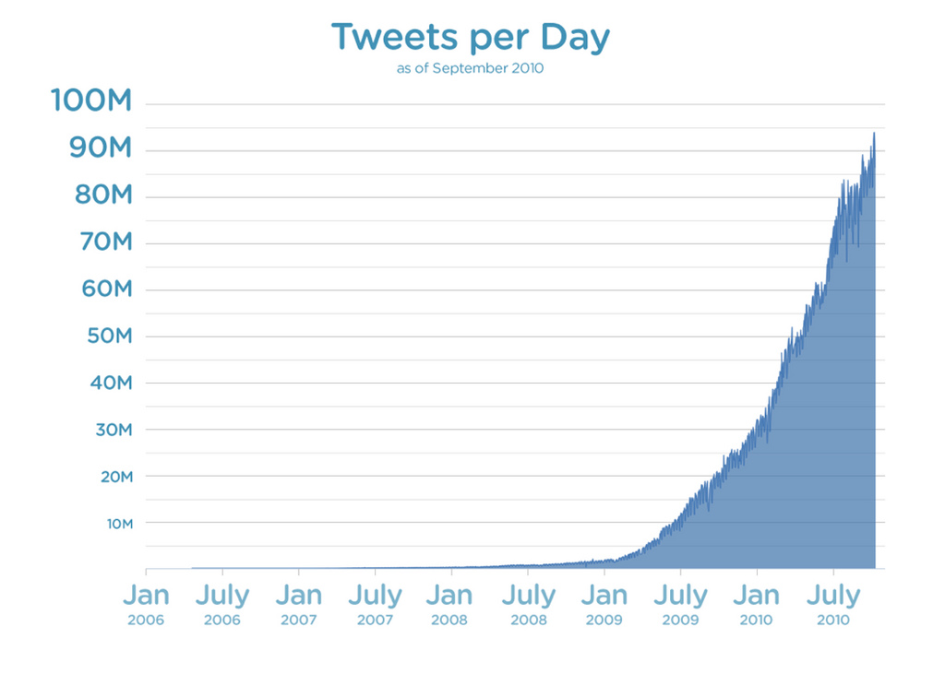
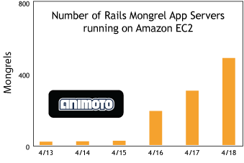
Motivation: Websites grow quickly
Twitter: 90+ Million Tweets / Day
Facebook: 4 Billion messages a day
http://blog.twitter.com/2010/02/measuring-tweets.html
http://blog.rightscale.com/2008/04/23/animoto-facebook-scale-up/
Notes:
An app can receive an amazing amount of traffic really quickly, so it’ll have to be ready to scale to meet the demand

Slide 4

Motivation: SLOs are everything
Delays under half a second impact business metrics
The cost of delay increases over time and persists
Google uses page load speed as a ranking factor
Websites that are too slow lose to their competitors.
Ex:
SCHURMAN, E., AND BRUTLAG, J. Performance related changes and their user impact. Presented at Velocity Web Performance and Operations Conference, June 2009.
Notes:
Segue: in spite of this rapid growth, you have to maintain good performance, or your rise in popularity will be short-circuited

Slide 5

Latency Matters
Scaling the app tier is straightforward
Developers find it difficult to write fast/scalable sites using a traditional RDBMS
Ex: Many of Twitter's "Fail Whales" caused by unintentionally slow DB queries [Chirp 2010]
Result: Web developers are abandoning the RDBMS and switching to NoSQL for large-scale interactive applications
Facebook, Twitter, Google, Amazon, Digg, Rackspace, RocketFuel, and many many more...

Slide 6
Traditional RDBMS
RDBMS
NoSQL
Powerful Declarative Query Language
Optimizer decides the best execution plan
Physical/logical data independence
Automatic parallelism
Performance Opaque
Easy to express queries that are computationally expensive (especially as the user base grows)
Large sites end up using them as a key/value store with proprietary layer on top or abandoning them…
Notes:
However, RDBMS’s were designed to provide some important advantages…

Slide 7
NoSQL Systems
RDBMS
NoSQL
Simple Query Interface
More complex queries are expressed as imperative programs that perform many simple operations
Changes to physical schema require developers to manually fix queries
Trivial Performance Model
Simple operations (get/put) generally have fixed latency
Expensive queries are obvious
Inherently distributed

Slide 8

PIQL: Know when to say No
RDBMS
NoSQL
Scale-independent declarative language
Only allow developers to write queries with a data-size-independent upper bound
Provides optimization / data independence
Performance feedback given to developer at compile time
Unbounded queries are disallowed
Potentially slow queries are identified
http://www.zazzle.com/pickle_delivery_tshirt-235678237870195464

Slide 9
PIQL: No slow query plans
RDBMS
NoSQL
Already known:
Potential for huge data sizes (you hope!)
SLOs: < 500ms
System automatically creates/uses:
Secondary indexes
Pre-computation (aka Materialized Views)

Slide 10
PIQL: Go where the data is
RDBMS
NoSQL
Designed to run on top of existing K/V Stores
Required operations: get, getRange, put, testAndSet
No Data Lock-in
Analytics: use Spark (Justin’s talk)
PIQL can’t run your query? Write it yourself.

Slide 11
PIQL: Make it easy to evolve
RDBMS
NoSQL
Developers want to rapidly add/remove features
You never get the schema right the first time
PIQL supports heterogeneous versions of applications and schema
Serialization using tagged record format
Online phased deployment of new versions

Slide 12
PIQL: Bounded Work
RDBMS
NoSQL
Most applications can tolerate cardinality constraints
People can only interact with a finite number of people (Facebook limits to 5000)
Twitter page sizes display only tens of tweets
PIQL lets developers specify these constraints in their data model => can retain joins
Optimizer uses constraints to evaluate performance safety (ie, will I violate my SLO?)

Slide 13

Is cardinality enough?
Anecdote: Robert Scoble, tech blogger “Facebook’s engineers tell me that the 5,000 friend limit is there because their engines have scaling problems. In fact, I’ve noticed parts of Facebook slowed down for me at about 3,000 friends.”
Facebook has a cardinality limit, but their performance suffers before the limit.
http://scobleizer.com/2007/10/14/the-you-dont-need-more-friends-lobby/

Slide 14
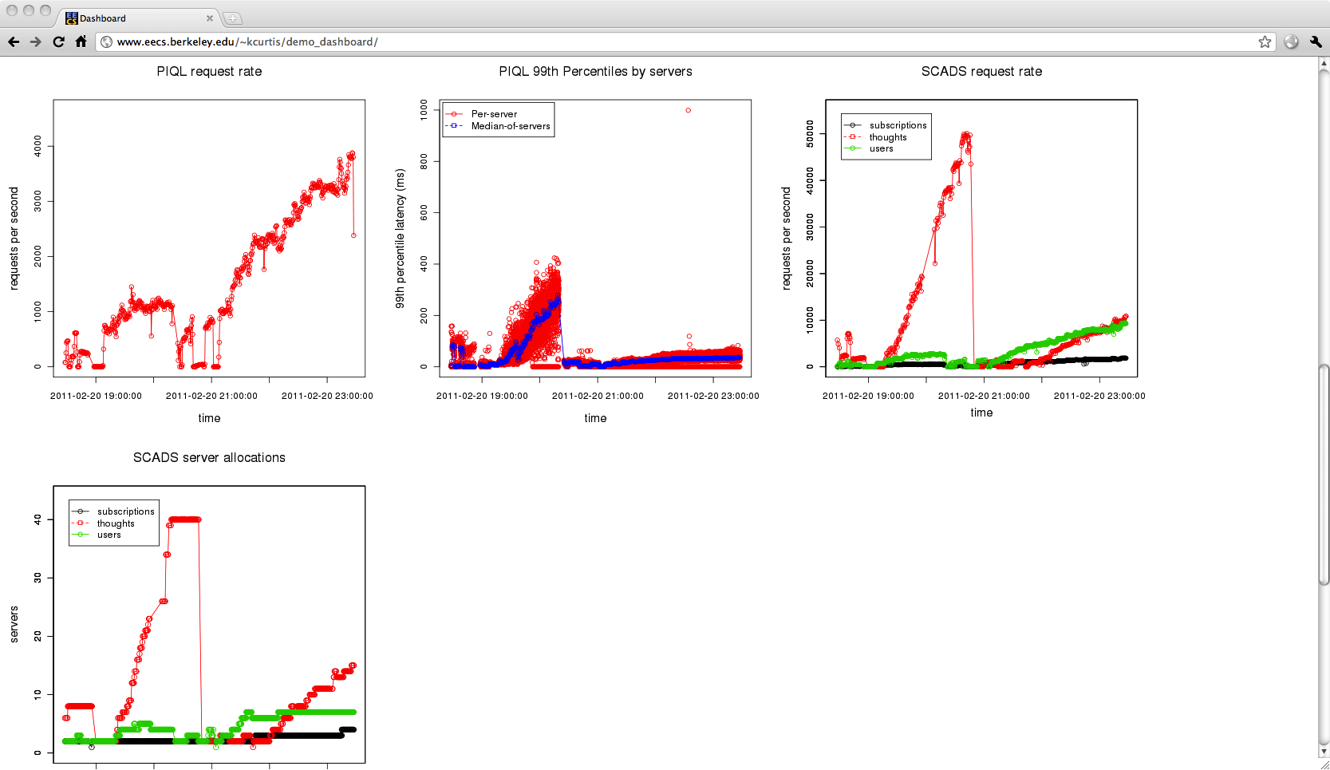
Danger of Bad Cardinalities
PIQL 90th Percentile Latency (Per Server)
90th Percentile Latency (ms)
S = 5000
S = 100
S = # subscriptions per user
Notes:
Point out that even with bad cardinality, things were fine when you started; they only go downhill when your app scales

Slide 15
Performance Insight Assistant
Unbounded Query:
Performance Insight Assistant
NO
usersFollowing
(Oprah)
90th %ile Latency
SLO
Bounded Query:
usersFollowedBy
(?,5000)
Performance Insight Assistant
OK
90th percentile
Cardinality

Slide 16
Assumptions
Director is working => storage system is meeting its SLO (Beth’s talk)
Low-level operations (eg, get, put) have predictable performance
PIQL SLO violations will come from high cardinalities
Can make predictions about high-level operations (ie, queries)

Slide 17
Performance Insight into SCADr
SCADr: Twitter clone
Queries fall into 3 cases:
No limit needed: findUser(?)
One limit needed: mySubscriptions(?, numPerPage)
Two limits needed: thoughtstream(?, maxSubscriptions, numPerPage)
We care about the latter 2 cases

Slide 18
Setup
5 SCADS nodes deployed on EC2 via deploylib
One trace collector per query on EC2 (running PIQL library)
Data:
10000 users
1000 subscriptions per user
100 thoughts per user

Slide 19

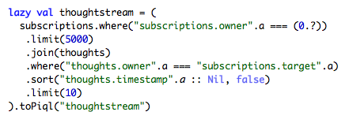
SCADr Queries
Number of subscriptions
Number of subscriptions
Number of thoughts per page

Slide 20
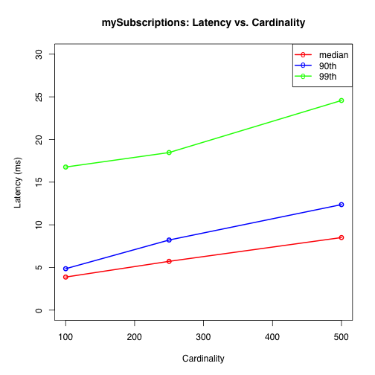
Case 1: One Limit
Inexpensive at highest cardinality => this query is not a bottleneck

Slide 21
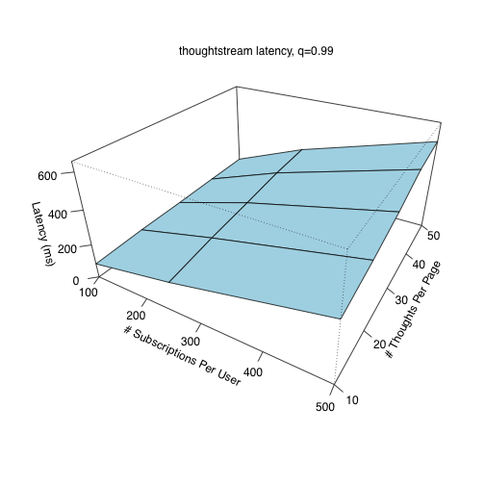
Case 2: Two Limits
Thoughtstream 99th Percentile Latency
SLO = 300 ms
OK
Notes:
Mention: straightforward to automate

Slide 22
Next Steps
Produce a linear model for each operator
Parameters: input size, data size, cardinality
Methodology for composing operator models to predict overall query latency

Slide 23
Conclusion
PIQL is a first attempt at combining developers’ favorite features from RDBMS + NoSQL
Declarative language with query optimization
Guaranteed predictable performance
No data lock-in
Flexible online schema evolution
Performance Insight Assistant provides feedback on cardinality choices

